Slide 1
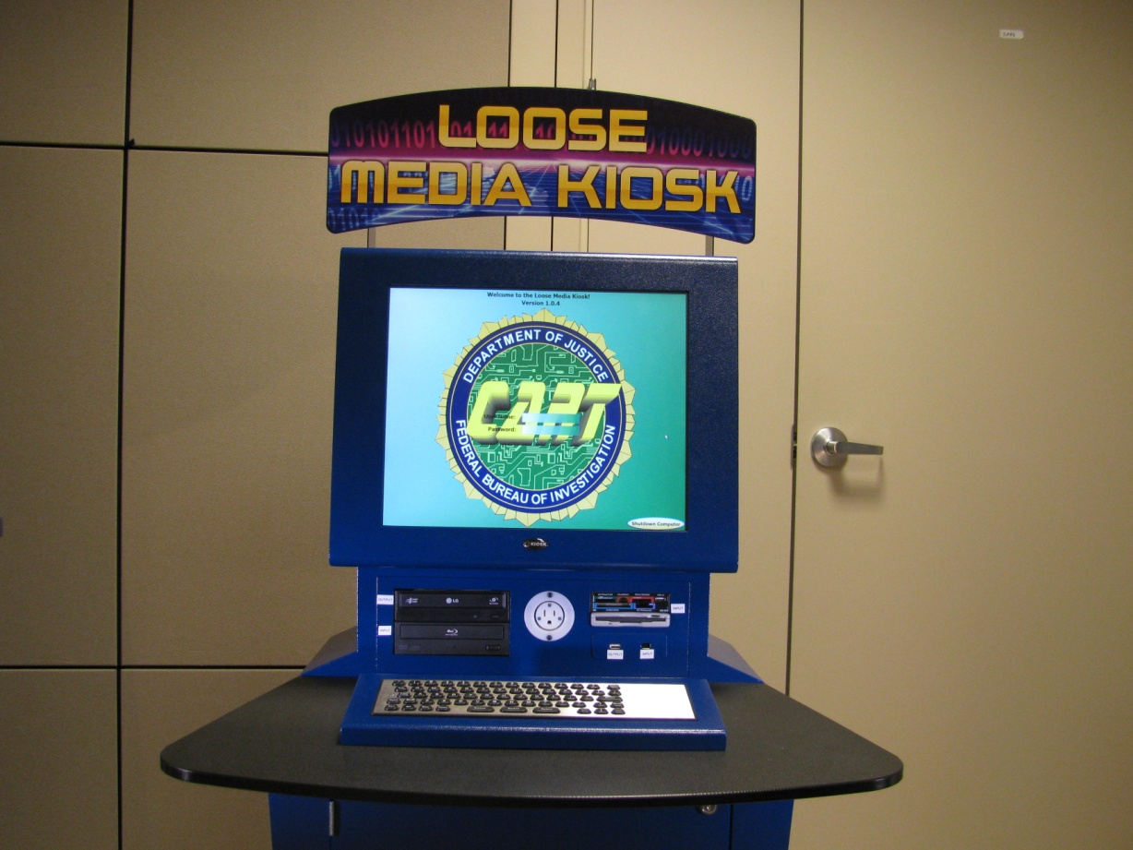
Loose Media Kiosk Quick Reference Guide

Slide 2
Table of Contents
User Sign On | Slide 3
Case Information | Slide 4
Update User Information | Slide 5
Examining Media | Slide 6
Recover Deleted Data | Slide 11
Progress Bar | Slide 15
Selecting New Input | Slide 16
Selecting Output Report Format | Slide 20
Output File Format | Slide 22

Slide 3
User Sign On Screen

Slide 4
Type in Case Information

Slide 5
Update User Information

Slide 6
When prompted by this screen, insert the
evidentiary digital media that is to be previewed.

Slide 7
Select the category of file that is to be previewed

Slide 8
File preview screen

Slide 9
File preview screen for video

Slide 11
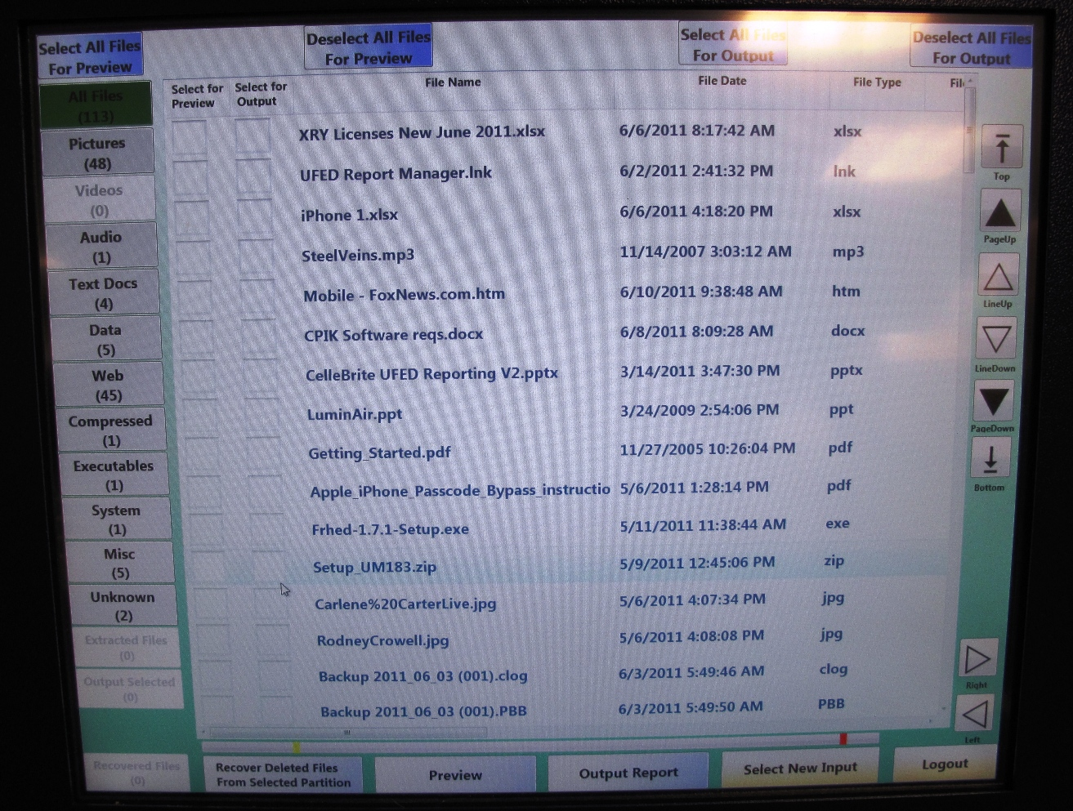
Recovering Deleted Data
The LMK allows users to recover many deleted file types
To recover deleted data, select the Recover Deleted Data button
from the bottom of the screen :

Slide 12
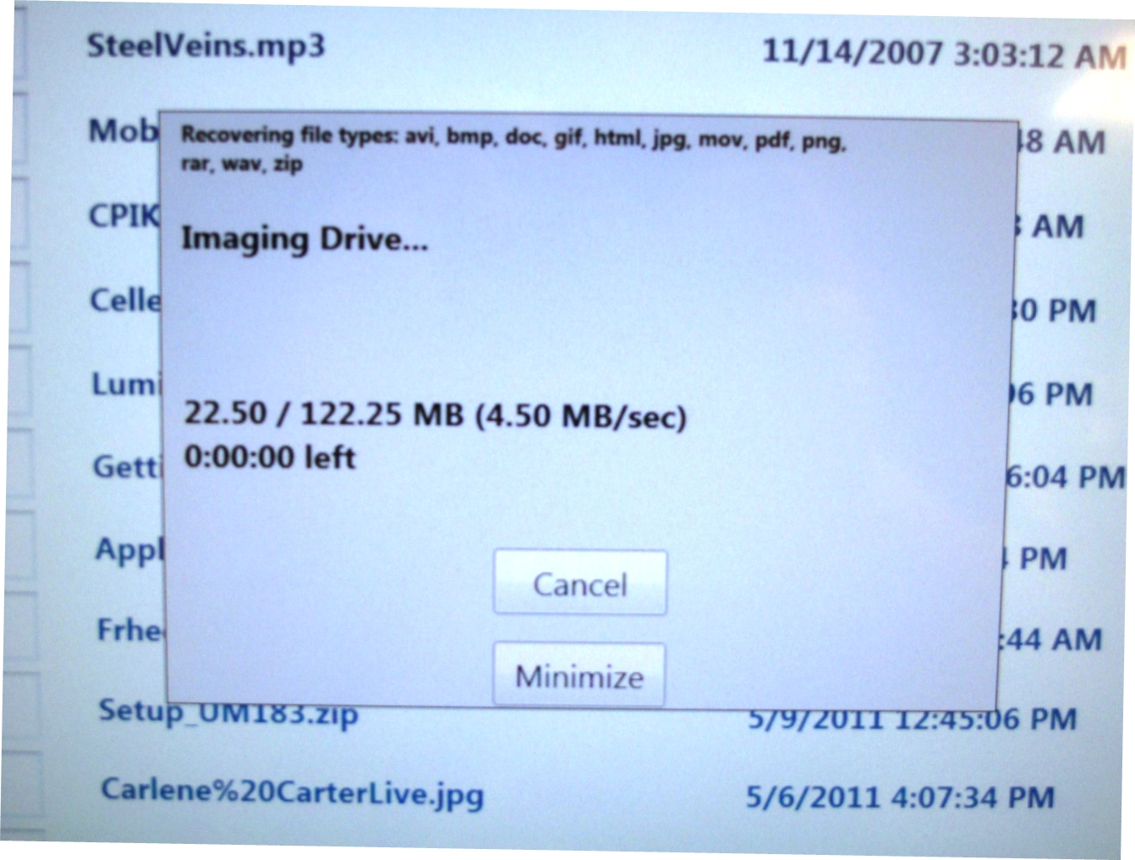
Recovering Deleted Data
The following box will be displayed showing the recovery progress
(Note: The time is displayed as (Days:Hours:Minutes)

Slide 13
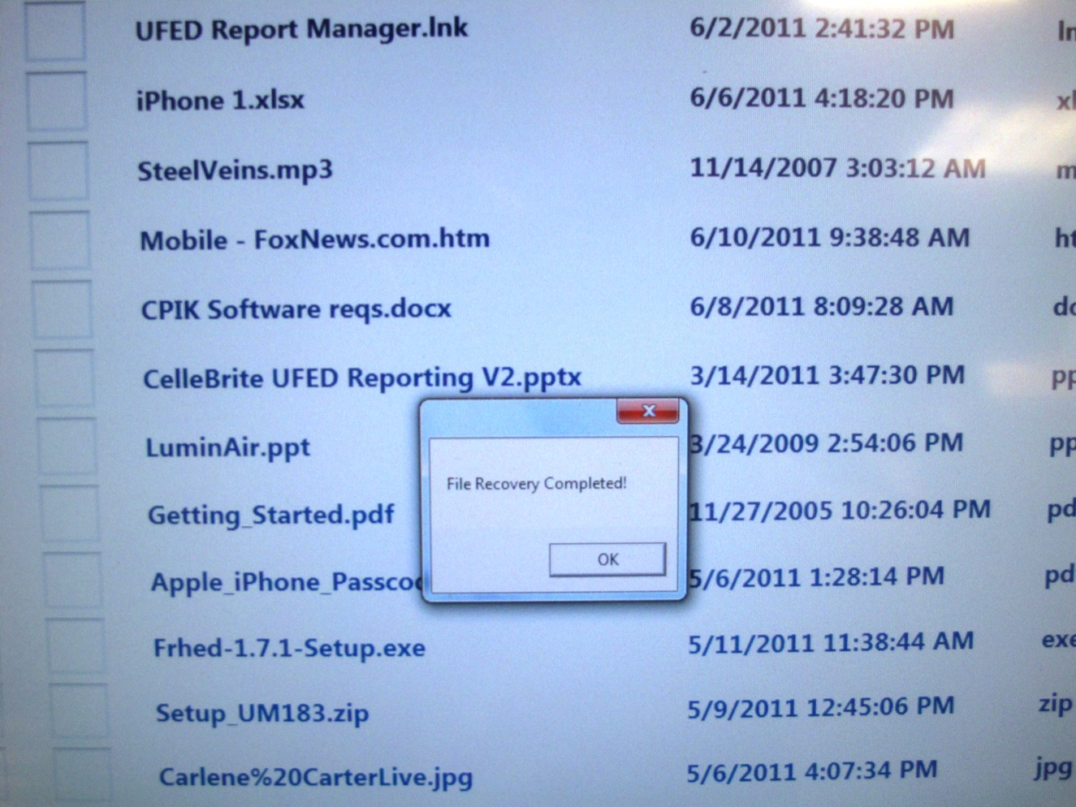
Recovering Deleted Data
Upon completion, the following box will be displayed.

Slide 14
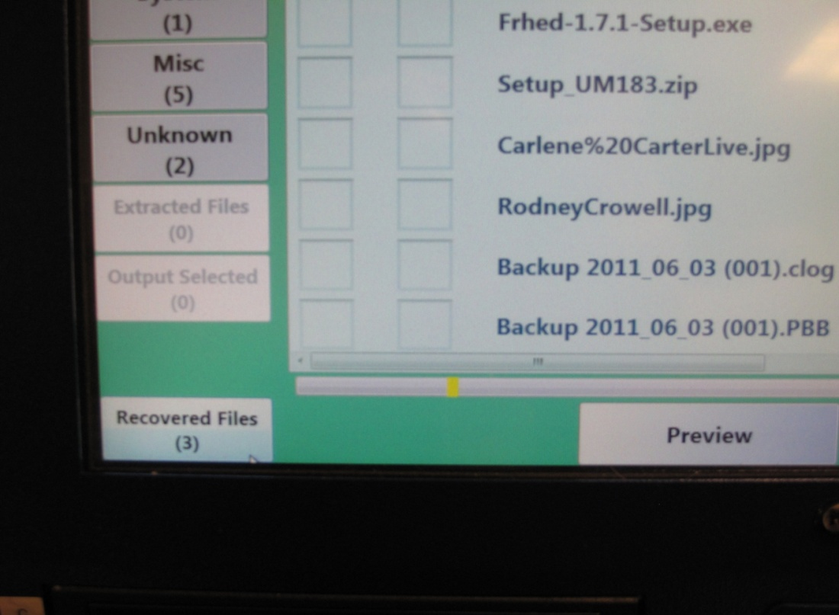
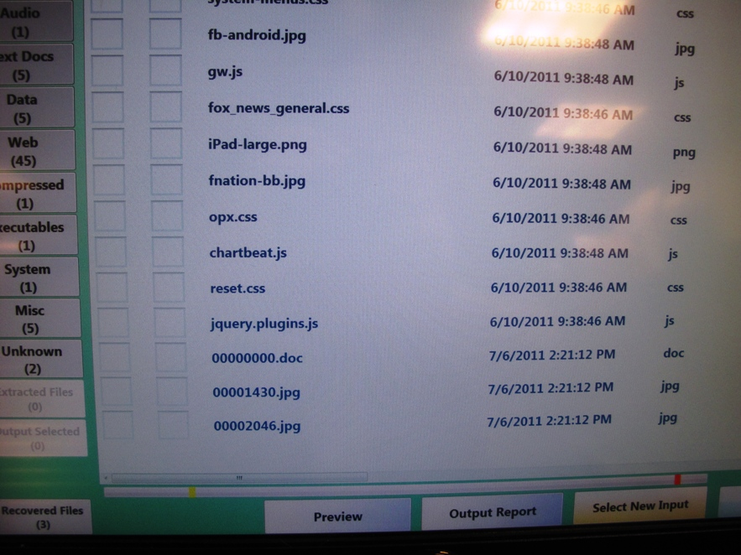
Recovering Deleted Data
Recovered data can be found by selecting the Recovered tab on the
left or at the bottom of the file list screen
Currently file names can not be recovered

Slide 15
Progress Bar
A progress bar is displayed at the bottom of the File List screen
- A yellow line to show the size of the files selected for output
- A red line to show the size of the output media

Slide 16
Selecting a New Input
There are two places in which to choose to view a different evidentiary input without having to reboot the kiosk

Slide 17
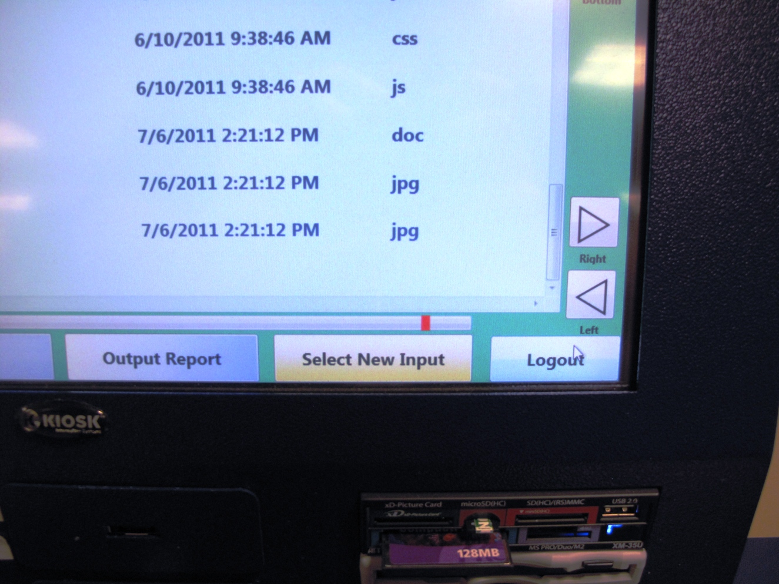
Selecting a New Input
The lower right corner of the File List screen

Slide 18
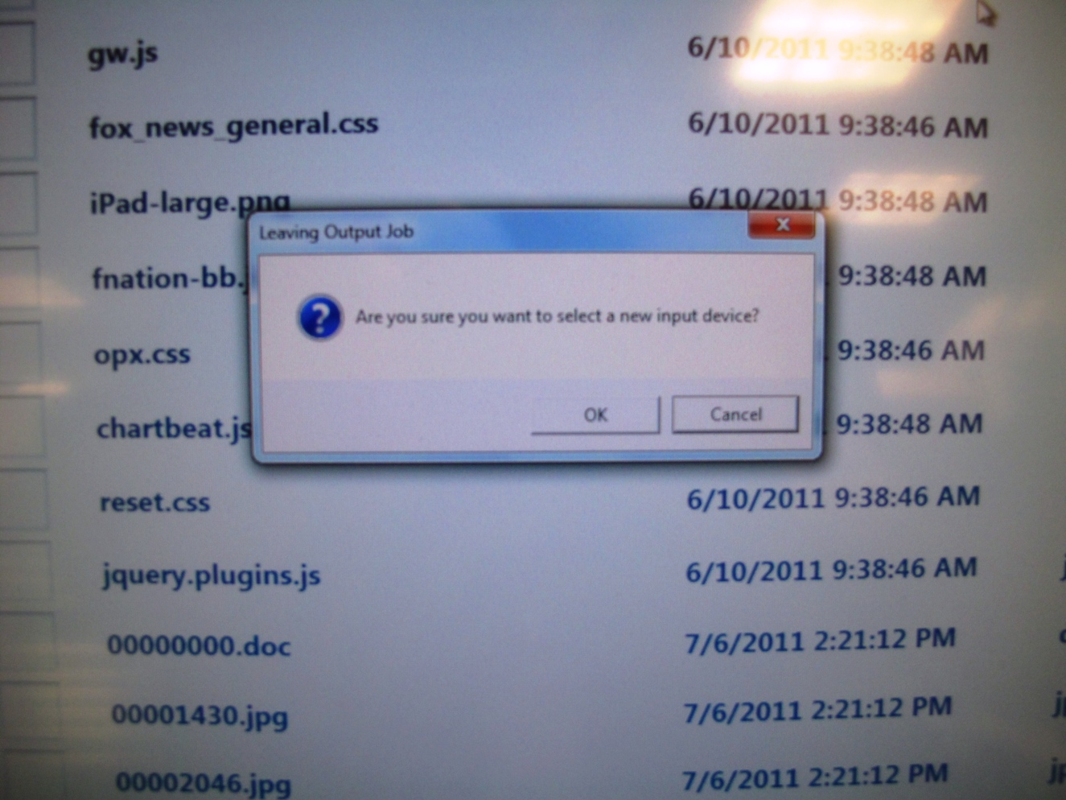
Selecting a New Input
After selecting the new input, select the OK button when prompted

Slide 19
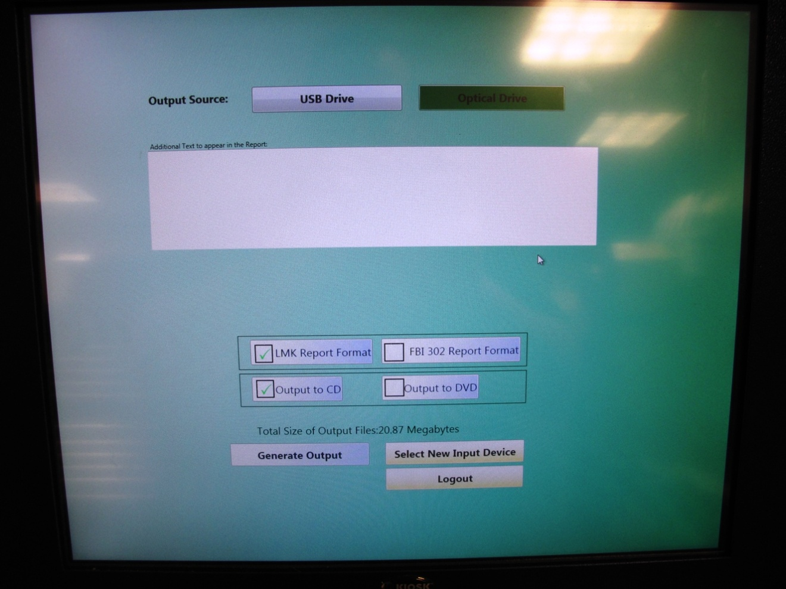
Selecting a New Input
A new input can be chosen from the File Output screen as well
NOTE: Each piece of media examined requires a separate report
If a piece of media is examined and a report is needed, ensure that a report is output before examining a new piece of media

Slide 20
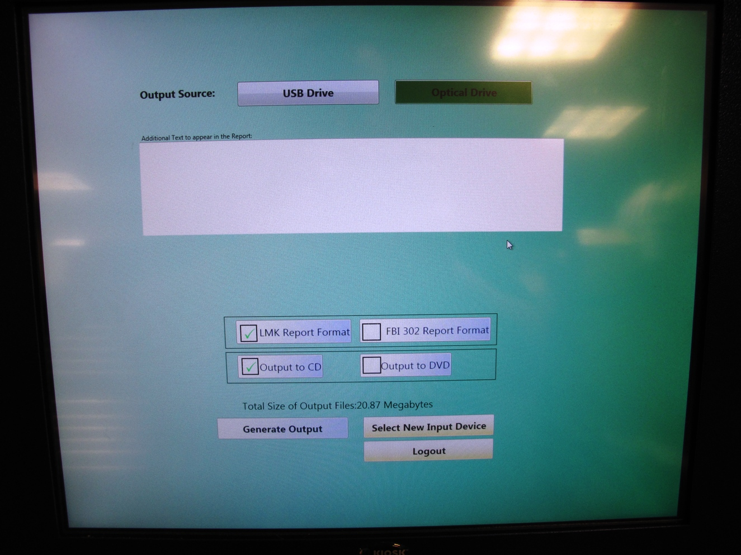
Select report format and CD or DVD output

Slide 22
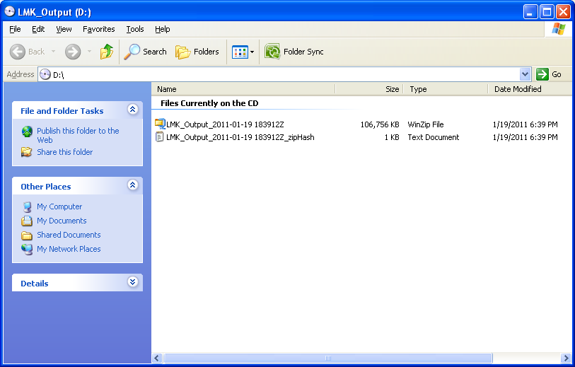
Selected output files will be contained in a single uncompressed Zip file

Slide 23
File format contained within the zip file

Slide 24
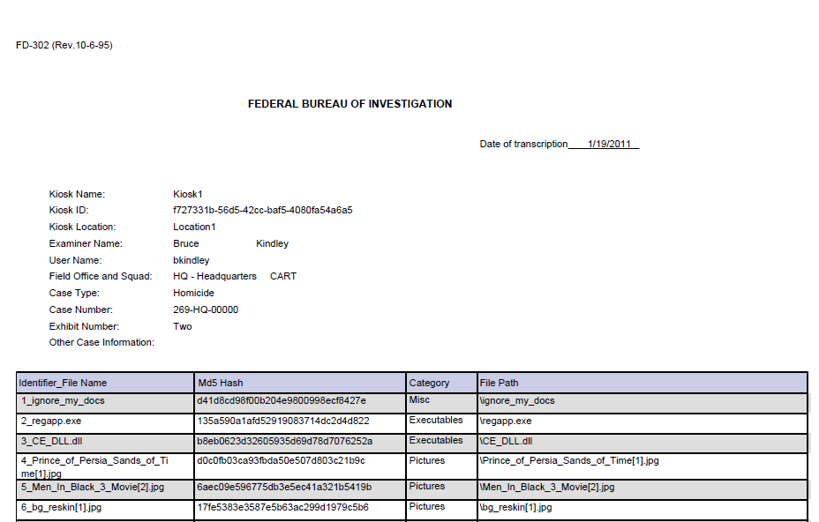
Files that are copied to CD are documented in a report along with their hash value and file path

Slide 25
